Slide 1

Finding a list of popular venues closed to TTC stations in Toronto
BY : Gayathri Sithampalam

Slide 2
Introduction
TTC (Toronto Transit Commission) is the main transport mode in Toronto.
Consists of subways, and bus stops In extreme weather they are the only hope for many commuters.
Being closely located near a TTC station gives a great amount of advantage
In Toronto, a TTC station that is within reach is considered as an added luxury by many.

Slide 3
Business Problem
To find a suitable location around a TTC subway station, to buy a house or open a business
I would like a place close to restaurants, banks, and other amenities
The main reason being I cannot drive, and I solely rely on public transportation

Slide 4
Data
A list of all the TTC stations and its coordinates in Line 1,2,3, and 4 will be used
Data for all the four lines were retrieved from : https://scruss.com/blog/2005/12/14/toronto-subway-station-gps-locations/.
All the venues in the vicinity were obtained with the help of Foursquare API.
Within a range of 500 meters and a limit of 100 venues.

Slide 5
Methodology
Read .csv file with all the coordinates
Use Nominatim and a plot these coordinates in a map by using folium
Use Foursquare API to acquire the venues close by and store it in a dataframe
Use One Hot Coding to convert these variables into binary values
Top 10 venues will be produced
5 clusters will be used and each venue will be assigned to one
A final folium map is used to show the clusters

Slide 6
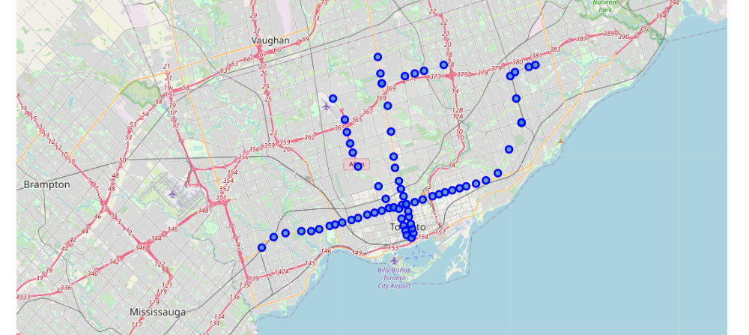
Toronto Folium Map

Slide 7
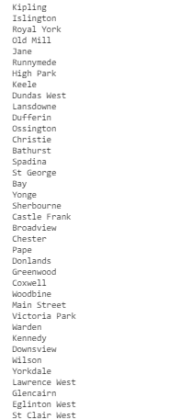
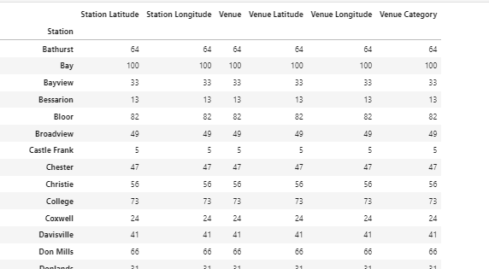
List of all the subway stations and venue details obtained

Slide 8
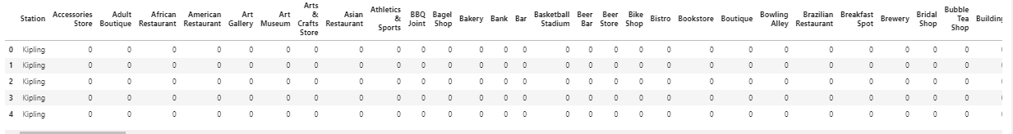
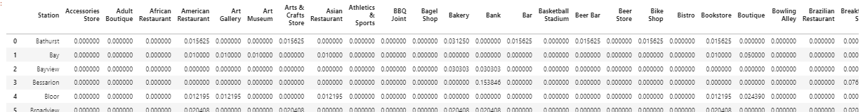
One Hot Coding

Slide 9
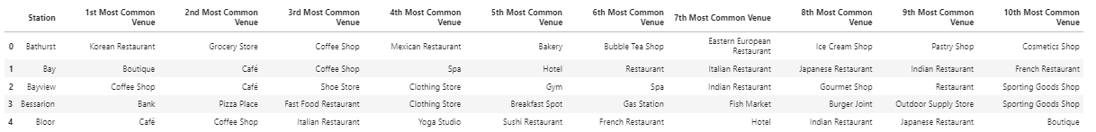
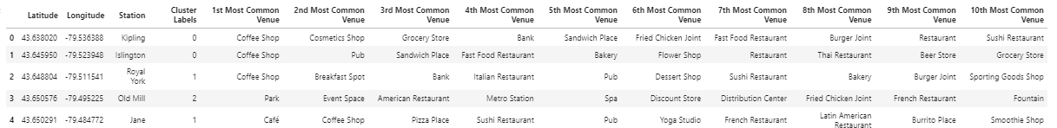
Top 10 Venues and K-means Clustering

Slide 10
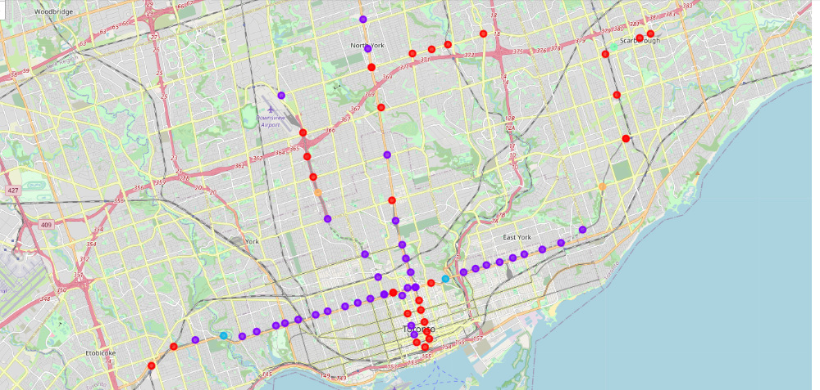
Folium Map of Toronto and the clusters

Slide 11
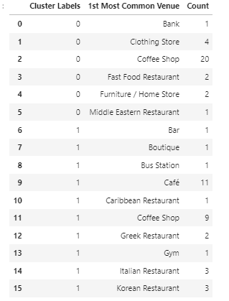
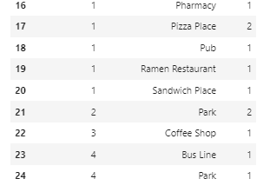
Results
Cluster 0 and 1 are more popular amongst the residents
Cluster 2, 3 and 4 less popular

Slide 12
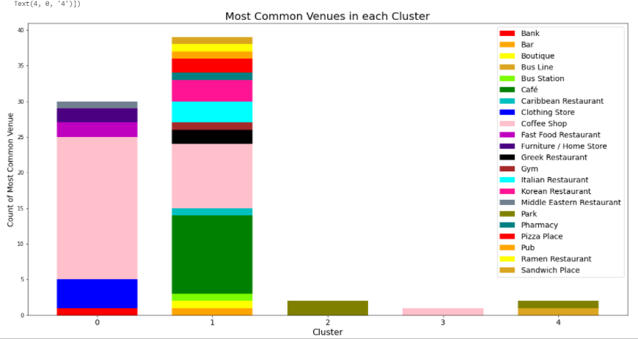
Discussion
Cluster 0 - consisted of a huge number of cafes, and other amenities
Cluster 1- was dominated by cafes and coffeeshops equally. Not to mention, it also had all the required range of restaurants, banks, and bus stations
Cluster 2, 3 and 4- were dominated by parks, coffee house and restaurants respectively.

Slide 13
Conclusion
Cluster 1 would be my primary choice based on the analysis, since it has all amenities
The close proximity of most of the subway stations and other activities forces me to choose Cluster 1 as the winner

